Slide 1
30–90 Day Digital Growth & Trust Plan
Website • Trust Assets • LinkedIn • YouTube • Google Local • CSR

Slide 2
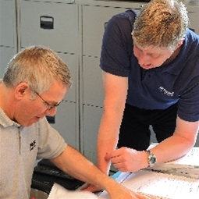
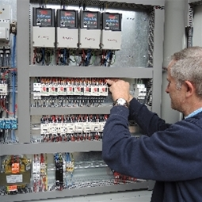
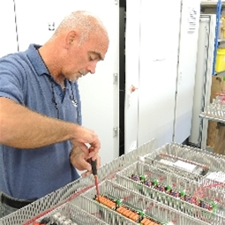
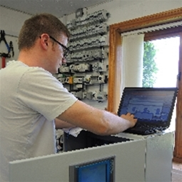
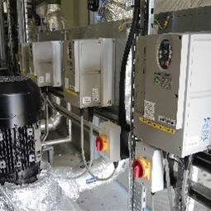




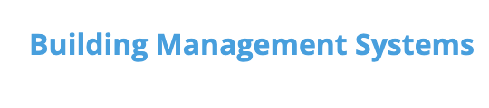
Website Plan: Days 1–23
Phase 1
23 day site build
Company Trust Pages
Service Pillar Pages
Persona
Pages
Pain point pages
Improve site structure Company, Service, Personas, Pain Points
Add clear navigation, and internal linking
Add clear calls-to-action and enquiry pathways
Publish foundational authority content
Credibility. Capability. Trust assets. Traffic & Conversion.
Launch core service pillar pages

Slide 3
Website Plan: Days 31–60
Publish solution cluster pages
(Launch first industry-specific landing pages
Add early case studies and project imagery
Optimize pages for conversion and search intent

Slide 4
Website Plan: Days 61–90
Expand into persona-based and pain-point pages
Add comparison and objection-handling content
Embed video and trust assets across key pages
Refine SEO based on early performance data

Slide 5
Company Trust Assets: Days 1–30
Professional photography of team, workshop, and projects
Company introduction video and workshop walkthrough
Certification, partner, and compliance visuals
LinkedIn profile and website visual refresh

Slide 6

Company Trust Assets: Days 31–60
Publish 3 core written case studies
Capture before-and-after project imagery
Create short-form project and engineer videos
Develop downloadable PDF assets for sales use

Slide 7
Company Trust Assets: Days 61–90
Advanced case studies with performance metrics
Client testimonials and success stories
Industry-specific trust content
Evergreen educational and proof assets

Slide 8


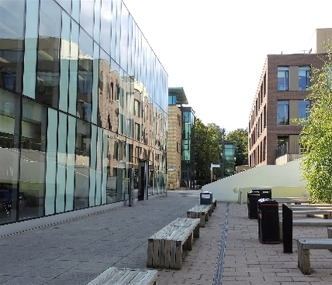
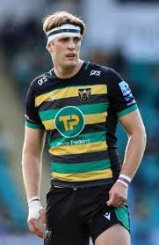
LinkedIn Showcase Plan (Day 60+)
2–3 posts per week focusing on proof and expertise
Project highlights, engineer spotlights, case studies
Short-form video clips repurposed from YouTube
Thought leadership from leadership team
Company news

Slide 9
YouTube Video & Shorts Plan (Day 60+)
Educational short videos (30–60 seconds)
SCADA, PLC, and refurb explainers
Behind-the-scenes and project walkthroughs
Repurpose Shorts for LinkedIn and website embeds
CSR Saints Alex Coles videos

Slide 10
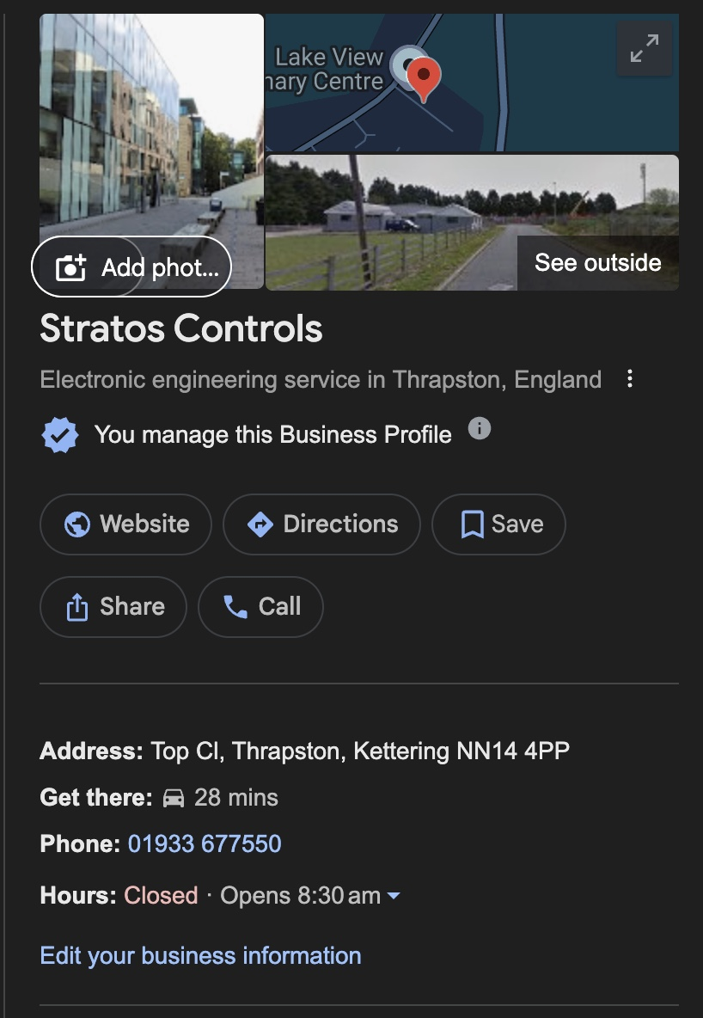
Google Local Business Page Plan
Weekly Google Business Profile posts
Project photos and short updates
Customer review collection process
Local keyword optimisation and service areas

Slide 11
CSR & Community Content Plan
Alex Coles Northampton Saints sponsorship content
Matchday posts and behind-the-scenes content
Community and youth sport support messaging
CSR storytelling across website and LinkedIn

