Slide 1


Conversion Paths
Suspect, Prospect and Customer
How to generate Search Engine Rankings and Web traffic
Session 1 – Getting Traffic Awareness Stage

Slide 2

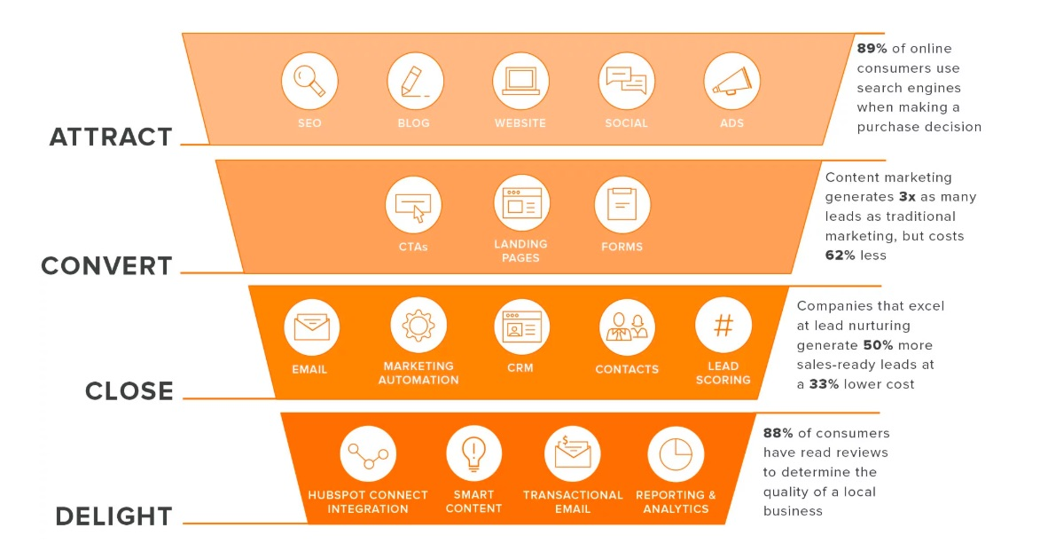
Standard customer conversion path thinking
4 Levels – Attract, Convert, Close, Delight.
Different Tools are required for each level
Looks Like a lot of work to set up a proper conversion path, however there are simple easy steps to follow
This deck will show you how to research keywords that have ”Search Traffic”
How to build a competitor list
How to load SERanking so it carries out your research for you

Slide 3


What Do these Stages Mean?
Conversion Stage | Awareness | Consider | Convert | Delight
Example problem I have a cold | Likely search “Google Top 3 Cold Cures” | Lemsip near me | Chemist Lemsip Offer | Don’t let them buy once – create lists of buyers using tools like HubSpot
These problems are what people search for | So, a Good awareness piece of content is “Top 3 cold cures” | Top cold cure suppliers of Lemsip Cold n Flu | Buy now 15% off Deliver to you | Email them offers
You need a list of these problem statements / phrases / questions – you create them as you research. SERanking, Google and competitors will teach you them if you research properly | In the article is a link to the next ”where do I buy the top cold cure?” In this instance “Lemsip” | This article will have Lemsip Suppliers Fred chemists £4.99 link Oli Chemist $4.79 buy now | These offers differentiate you when the buyer has decided I’m buying lemsip | Next autumn Lemsip offers
Here’s a typical everyday purchase path – for someone with a cold

Slide 4

Let's start with the “attract” phase
Definitions
SEO – Search engine optimization = plain English = ranking high on the page in search engines
Blog – Commentary often used to update folk – However real purpose “spell out issues, problems you solve”
Website – Often what people build first however, I'd argue not till you have researched search terms, customer journey etc
Social – Social media sites – these are full of network where people learn, connect, share experiences, refer people
ADS – PPC pay per click campaigns – where Google Facebook make their money
Tip 1 – DO NOT SELL – people back off sellers, they love educators, people who show them how to fix issues
Tip 2 – At attract / awareness stage you need to think of yourself as a publisher of “how to fix issues”
Tip 3 – These Problems or issues you share will be shared amongst networks, the better they are the more they are shared
Purpose – All you are doing at the awareness stage is explaining how to fix issues – educating
– the CTA call to action at the end of the problem-solving blog, article, landing page, post will be a natural step
- It will fill your pipeline with “suspects”
Suspects explained – EXAMPLE – you’re a golfer – you have a problem – you slice the ball – the fix “a lesson”
However, a simple video, how to fix a slice – will get you traffic - they will then try and fix it themselves – most will fail
Suspects will have different “personas” explained later

Slide 5
Rule 1 Awareness Stage - Research
Do not assume people come to your website to learn!
Why?
If you are not on the first page of Google
If you are not ranked in the Top 3 Organic returns
They probably will not find your website
People learn off folk they trust, where they normally learn.
Forums, Social media, Websites that have subject matter authority
So, you must think carefully, what problem am I solving?
What keywords would someone search for to find the answer?
Where would they look?
Then start to prepare your content “that educates” them towards “how to get the answer”
The secret DO NOT SELL, “educate them, towards the answer”

Slide 6
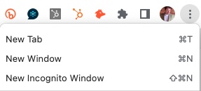
Rule 1 Awareness Stage – Get a research tool (to cut down the effort time and cost (i.e., don’t guess how to get customers, that wastes time and money)
How to start learning to organize content
Step 1 – buy a 1-month subscription to SERanking / SEMRush
Cost £30-40 this will enable you to start researching “the challenge”
What Challenge?
The challenge of getting people to your website
The challenge of generating traffic
Step 2 – open Google Chrome, Top right switch to “incognito mode”
Why? This remove cookies in your PC/ Laptop from influencing your searches
Now start to Google “Search terms you think people will search for”
“Under Armour near me” “Under Amour Deals” “ Under Armour Golf Tops”
The next slides show
you how to use the tool

Slide 7
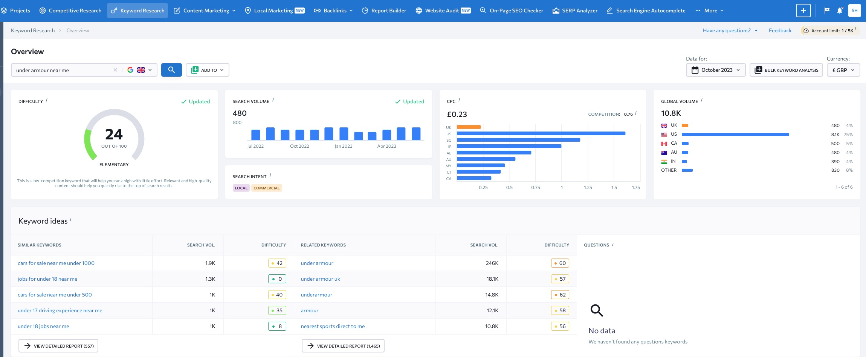
Rule 1 Awareness Stage
Keyword you want to learn about
Up will pop all the things you need to know about this keyword

Slide 8
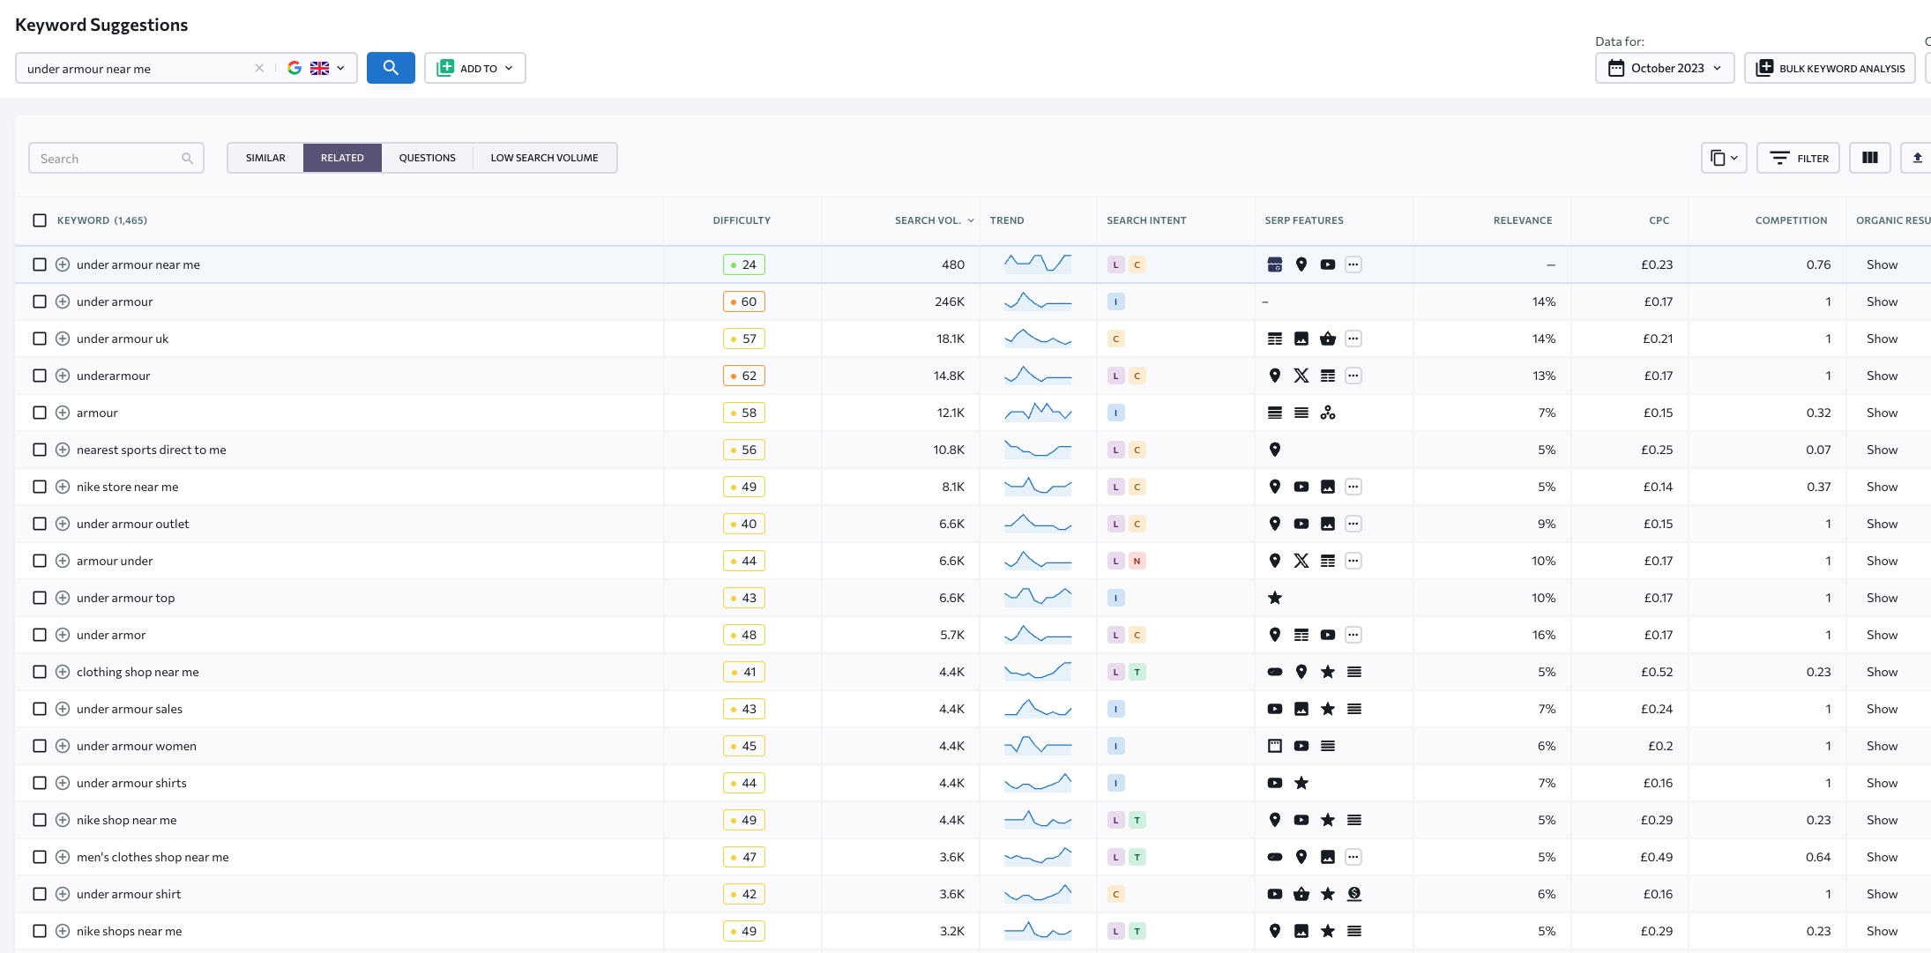
Awareness Stage 1 – Research
Click on keyword suggestions – up comes the list, there search volumes, search trends

Slide 9
Awareness Stages
Research what keywords Rank
Research competition
What terms they rank for
What problem statements they address
How hard it is going to be to rank – see keyword difficulty
What content do we need to produce to educate suspect buyers
Where does that content need to go – social media, forums etc
What is the conversion path?

Slide 10
So Now you have your first list of keywords
Go to the competition section in SERanking
Enter the domain names of the competitors
You will now learn
Where you rank v competition
How hard it is to beat them
How much traffic they get
How much it cost to pay per click (ppc) short term till you rank
How many search words they rank for
See the next page for an example

Slide 11
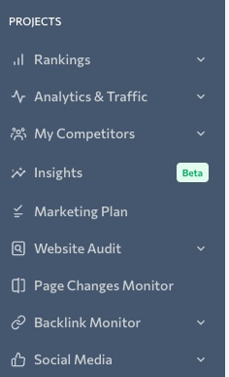
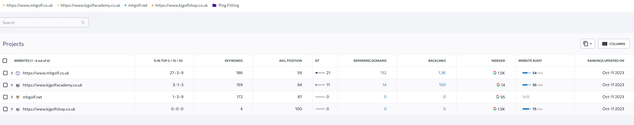
Rule 1 Awareness Stage
Step 3 – Go to SERanking
Enter the competitor’s website domains in the competitor section
SERanking will then look in Google and do your research for you
This table will appear

Slide 12
Rule 1 Awareness Stage
Under Competitors Domain this table will appear
From other sites to yours
Again, an indicator of quality
How good technically
The website is delivered to the internet
Domain names
Of the Keywords you have identified
How many your competitor ranks for
How trusted their website is.
DT= domain trust
Keywords the
competitor ranks for by
Top 3
Top 10
Top 30
Gives you a gauge
How good they are
How many keywords they are indexed for
If you have only found 186 and they have 1,500
You have more research to do
The more domains link to yours
The more respected they are
The higher the domain trust
Domain trust affects Google Rankings
Where they rank
For those keywords
Across them all

Slide 13
Why is your website of secondary importance if you're not ranked or just starting?
Because you have no traffic
No domain authority
No credibility in Google
No search words that you rank for
The search words you do rank for have no website traffic
This is where 100% of companies start
This is where 99.9% remain, risking survival on luck!

Slide 14
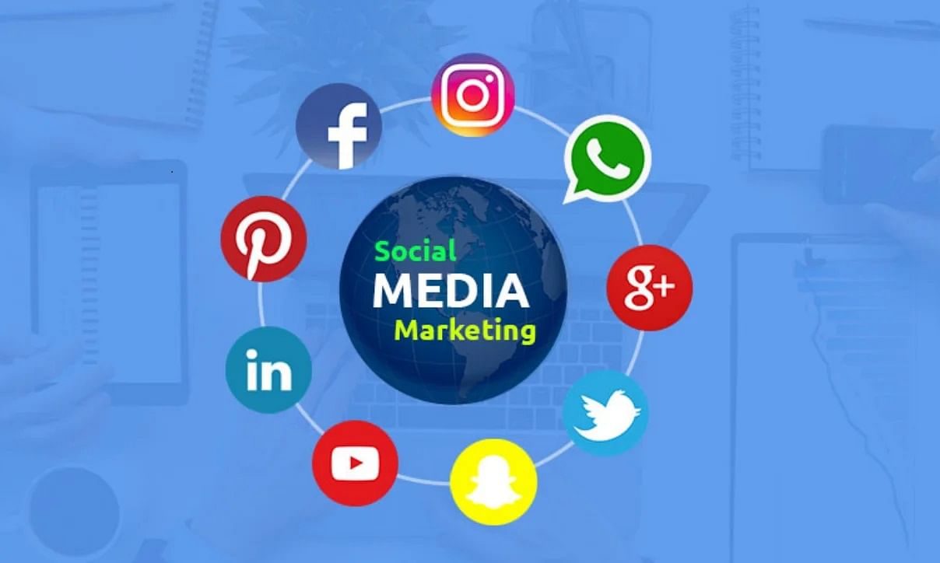
How to shortcut the attract / awareness stage?
Area | Social media Sites | Key elements | Advantage | Thinking
Characteristics | They are huge – so Google sends its spiders to them continually | These sites are Google triangle friendly | You can drive traffic to your website from these before it ranks itself | Think about what problem your solution can solve and “educate” them here where they learn and share stuff – it will enable you to build traffic and
Key Learn | Quality Content placed here, on social sites ranks quickly. | Video , Images, Word Content correctly tagged will rank here fast. | Tagging photographs and Images, Video properly can get you fast results | Mapping this properly BEFORE you build websites will inform your website build. Too often people build a website 1st then think about the traffic and then converting it. That’s the wrong order.
Common Mistakes | Publish loads on “untagged” content and all you will do is get is more and more followers but never any business. | Tagging to rank for keywords is easy, just check the image sizes every site likes, then the site will digest your content easily. | People don’t think about the personas, the types of people that could arrive with the same problem. Therefore, the content only appeals to some of the target audience. | People publish content that doesn’t address a problem, or the different types of people with the same problem.

Slide 15
A little Research and Planning shortcuts 5 years into 1 year
Fail to plan
Plan to fail

Slide 16

Suspects are many and varied
Tip 4 Do not assume they are the same
Here’s where we introduce persona’s
Let’s use golf again
Problem – I slice the ball
Persona (could be many reasons)
  I’m old I don’t pivot well
  I’m young I have never had a lesson
  I have clubs with weak shafts, so I come through ball contact with the face open
  I have a poor stance – my shoulders are open
Question?
Do these personas need the same fix?
Answer
Tip 5 No so, so don’t take them to the same place
Tip 6 Should you treat them the same way?
A little thought and you start to design the Top of your funnel journeys well.
This enables you to design your Call For Action “free 15-minute diagnostic clinic”
This enables you to design your problem pages with a simple call to action
(no selling just educating and helping)

Slide 17
How do I route or deal with different personas?
I have a poor stance – could easily be identified “with a free 15-minute diagnostic session”
Question
Would that identify the other personas?
Yes
How many are there then?
Are the fixes the same?
The old guy that doesn’t pivot well – might just need some exercise routines
So, you give them a route to a simple set of video’s
I have clubs with weak shafts, could that be identified in the diagnostic session
I have the wrong sized grips
Another persona – I have too large a grip – come through open at contact

Slide 18

Journeys – attract stage – golf example
Persona | I slice | Grip Size Wrong | Shaft Weak | Old cant turn | Poor Stance Poor Grip
Stage Attract | Simple video and blog on the 8 reasons you could slice | Explainer video | Explainer video | Explainer Video | Explainer video
Content | Blog Video Images illustrating: -Grip size wrong -Shafts weak -Old cant turn -Poor stance -Poor Grip | Grip Size 1.Explainer Video 2. Blog on Grip size affecting slice hook | Shaft Weak Shaft Strong Explainer Video Explainer blog | Video blog images all showing problem and solution Golf exercises for seniors Pivot exercises | Video blog images all showing problem and solution Poor stance Poor grip
Call to action | Several Free 15 min Diagnostic session Free Exercise drills | CTA 15-minute free diagnostic | CTA Diagnostic 15 minutes With Trackman | Buy exercise rubber bands here Buy wrist strengtheners here | Free 15-minute diagnostic session book here
Consider stage |  | We price match competition , we fit for free – Buy online here | We price match competition – fitting offer | Price Match Pick n Collect SMS when in | Lesson offer Video of diagnostic Book here now

Slide 19
Tools
People often find cheap tools to help them with
Videos
Blogs
Booking engines
Contact managers
Email blasts
However, the answer could be a platform that does it all

Slide 20

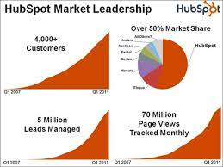
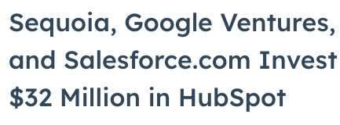
Why we choose HubSpot
They save you lots of money – wasting time getting traction – result shortcut 5 years work into 18 months
You can find cheaper alternatives
You can find components of HubSpot that are better
However, HubSpot have an Integrated Approach…. Let me explain

Slide 21
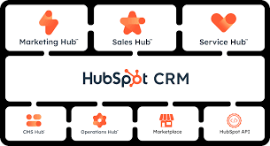

Tools
You do not need all these elements when you start
However, as you grow you will need
Better tools – HubSpot have different levels of CRM etc
HubSpot have thought about you growing…….
You will need to integrate tools like
- Payment platforms
- Phone systems
- Social platforms
HubSpot have thought about who you need to integrate with
This saves developers cost and time @£500 a day

Slide 22


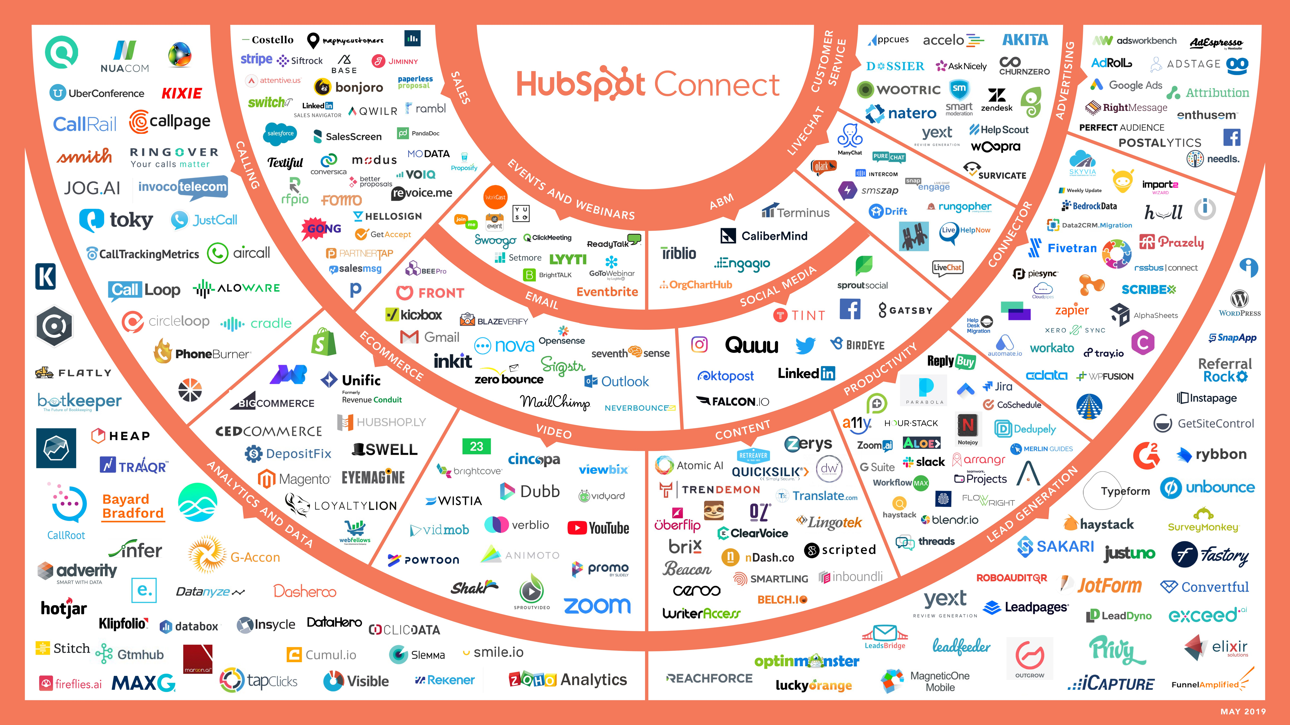
Hubspot apps
These are all the APPs they Integrate too saving you time money and speed of execution – integrating to apps is often just authorizing them to talk through a scripted 5-minute process

